Slide 1


Xcode Career Service
关注 Xcode 即可获得热腾腾的高频题解析视频、面试技巧及准备tips、北美IT就业咨询等干货
一对一实习或工作信息咨询服务
一对一面试能力评定 + 修改简历
一对一Mock interview强化训练服务

Slide 2
想进 xcode 的刷题群，请加老师微信 singerdmx， 他会拉你进群

Slide 3
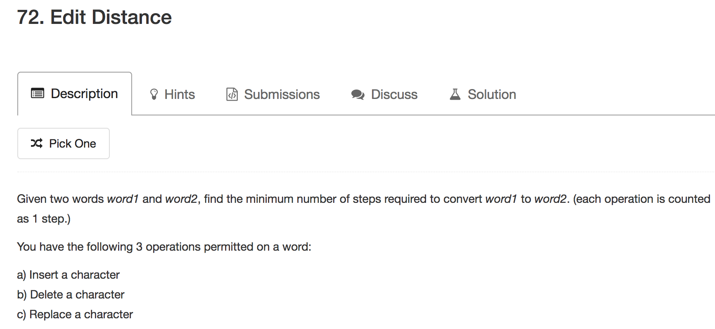
Mock

Slide 4



Slide 5

K Edit Distance

Slide 6

Given a set of strings which just has lower case letters and a target string
Output all the strings for each the edit distance with the target no greater than k
You have the following 3 operations permitted on a word:
Insert a character
Delete a character
Replace a character

Slide 7
Example
Given words = ["abc", "abd", "abcd", "adc”, “ad”, “a”] and target = "ac”
k = 1
Return ["abc", "adc”, “ad”]
"abc” => delete “b” => “ac”
"abd”
"abcd”
"adc” => delete “d” => “ac”
“ad” => replace “d” with “c” => “ac”
“a” => add “c” => “ac”

Slide 8
Naïve Solution
For each word in the list, calculate the edit distance with the target word.
If it is equal or less than k, output to the result list.
If we assume that the average length of the words is m, and the total number of words in the list is n.
So target word is of length m, and one single edit distance operation is m^2.
The total time complexity is O(n * m^2).

Slide 9
Optimal Solution
The problem with the previous solution is if the given list of the words is like ab, abc, abcd, each time we need to repeatedly calculate the edit distance with the target word.
If we can combine the prefix of all words together, we can save lots of time.
Trie + DP

Slide 10
Words: "abcd", "abc", "abd", "ad", "c", "cc”
Target: “abcd”
K: 2
Output: abc, abcd, abd, ad

Slide 11
TrieNode root = new TrieNode();
List<String> getKEditDistance(String[] words, String target, int k, TrieNode root) {
List<String> result = new LinkedList<>();
int minLen = target.length() - k, maxLen = target.length() + k;
for (String s : words) {
// Prune
if (s.length() >= minLen && s.length() <= maxLen) {
root.add(s);
}
}
Words: "abcd", "abc", "abd", "ad", "c", "cc”
2<= length <= 6

Slide 12
Words: "abcd", "abc", "abd", "ad", "cc”
class TrieNode {
boolean isWord;
TrieNode[] children;
public TrieNode() {
children = new TrieNode[26];
}
}

Slide 13

Words: "abcd", "abc", "abd", "ad", "cc”
root
a
c
b
d
c
c
d
d

Slide 14
DP 核心思想
（1） Deduction Formula
（2） Initialization
（3） Space Improvement (Bonus)

Slide 15

（1） Deduction Formula
int[] prevDist = new int[target.length() + 1]
int[] curDist = new int[target.length() + 1]
More Contents Incoming
后期会加内容

Slide 16
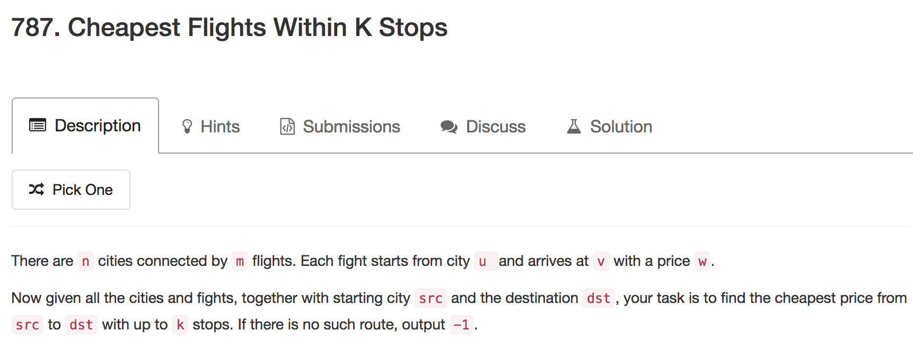

Slide 17
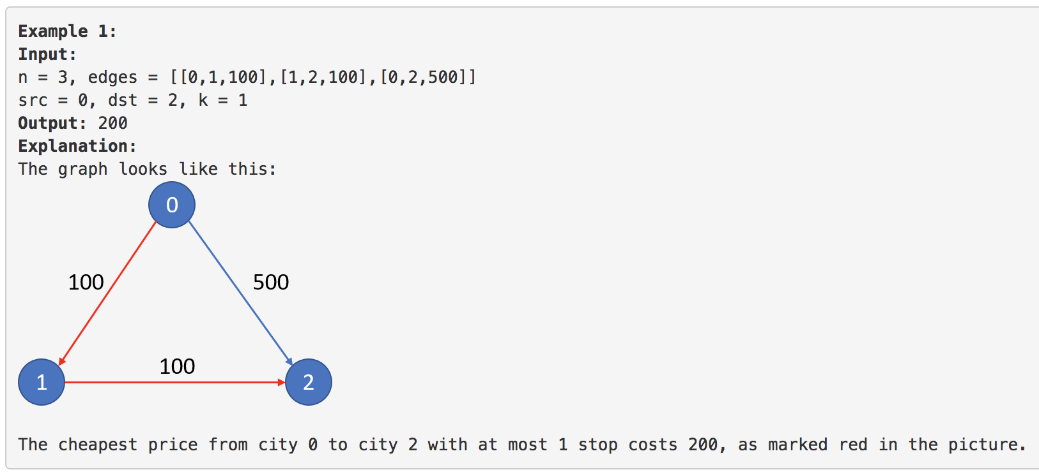

Slide 18
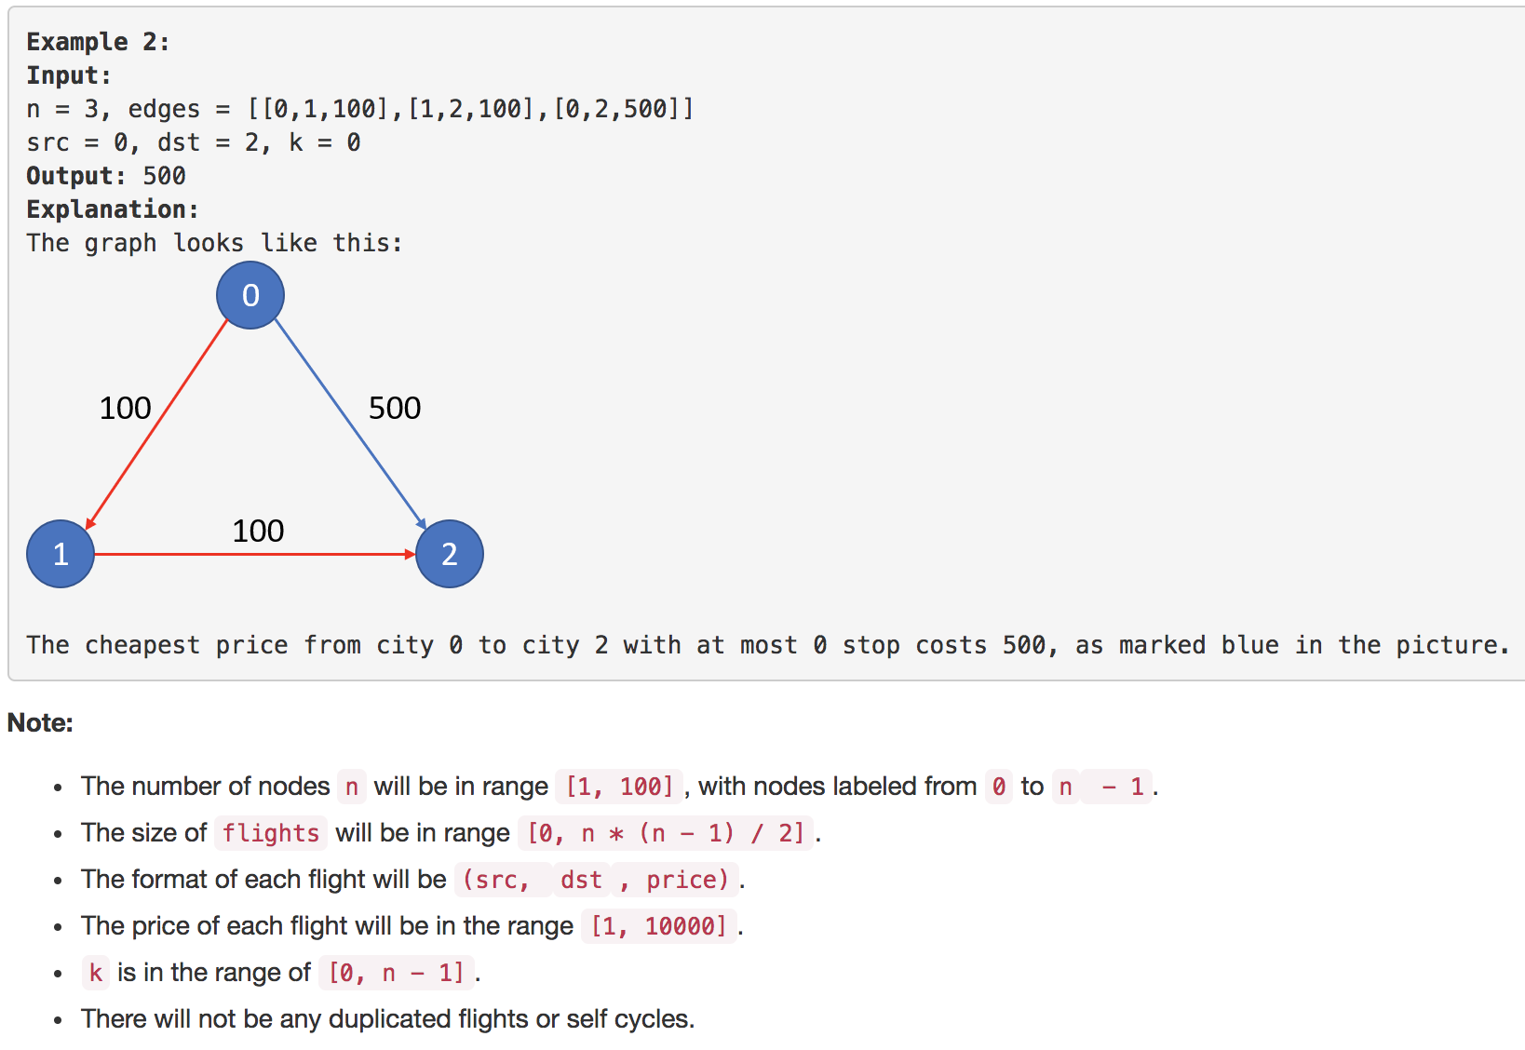

Slide 19
DP 核心思想
（1） Deduction Formula
（2） Initialization
（3） Space Improvement (Bonus)

Slide 20
（1） Deduction Formula
public int findCheapestPrice(int n, int[][] flights, int src, int dst, int K)
int[][] dp = new int[n][K + 1]
dp[x][k] means: city x's minimal distance from city src, with the restriction of maximal k stops in the route

Slide 21
（1） Deduction Formula
int[][] dp = new int[n][K + 1]
dp(x, i) = dp(y, i-1) + flight(y, x)
Flight Y ➔ X
City Y
City X
at most i – 1 stops
i stops
+1 stop at City Y

Slide 22
（2） Initialization
for (int[] arr : dp) {
Arrays.fill(arr, Integer.MAX_VALUE);
}
dp[src][0] = 0
NO Flight
City src
City src
0 stop

Slide 23
City 0
500
City 2
400
City 4
100
100
200
100
City 1
City 3
300

Slide 24
（2） Initialization
n = 5
edges =
[0, 1, 100], [0, 2, 500]
[1, 2, 100], [1, 3, 300]
[2, 3, 200], [2, 4, 400]
[3, 4, 100]
src = 0, dst = 4, k = 2
 | 0 stop | 1 stop | 2 stops
City 0 | 0 | MAX | MAX
City 1 | MAX | MAX | MAX
City 2 | MAX | MAX | MAX
City 3 | MAX | MAX | MAX
City 4 | MAX | MAX | MAX

Slide 25
（2） Initialization
// direct route, no stop
for (int[] f : flights) {
if (f[0] == src) {
int dest = f[1];
int cost = f[2];
dp[dest][0] = cost;
}
}
Initialize first column

Slide 26
direct route
 | 0 stop | 1 stop | 2 stops
City 0 | 0 | MAX | MAX
City 1 | 100 | MAX | MAX
City 2 | 500 | MAX | MAX
City 3 | MAX | MAX | MAX
City 4 | MAX | MAX | MAX

Slide 27
Traverse all cities
Update the minimal distance from last loop‘s result, used for current loop
Because
dp[j][i] <= dp[j][i - 1]
for (int j = 0; j < n; j++) {
dp[j][i] = dp[j][i - 1];
}
If you can get to city X with i – 1 stops,
then you can at least do the same with i stops

Slide 28
Firstly carry over
 | 0 stop | 1 stop | 2 stops
City 0 | 0 | 0 | MAX
City 1 | 100 | 100 | MAX
City 2 | 500 | 500 | MAX
City 3 | MAX | MAX | MAX
City 4 | MAX | MAX | MAX

Slide 29
// greedily update all routes
for (int[] f : flights) {
if (dp[f[0]][i - 1] == Integer.MAX_VALUE) {
continue; // no route to this point
}
int dest = f[1];
int cost = f[2];
dp[dest][i] = Math.min(dp[dest][i],
dp[f[0]][i - 1] + cost);
}

Slide 30
 | 0 stop | 1 stop | 2 stops
City 0 | 0 | 0 | MAX
City 1 | 100 | 100 | MAX
City 2 | 500 | 200 | MAX
City 3 | MAX | 400 | MAX
City 4 | MAX | 900 | MAX

Slide 31
0 ➔ 1 ➔ 2
 | 0 stop | 1 stop | 2 stops
City 0 | 0 | 0 | MAX
City 1 | 100 | 100 | MAX
City 2 | 500 | 200 | MAX
City 3 | MAX | 400 | MAX
City 4 | MAX | 900 | MAX

Slide 32
0 ➔ 1 ➔ 3
 | 0 stop | 1 stop | 2 stops
City 0 | 0 | 0 | MAX
City 1 | 100 | 100 | MAX
City 2 | 500 | 200 | MAX
City 3 | MAX | 400 | MAX
City 4 | MAX | 900 | MAX

Slide 33
0 ➔ 2 ➔ 4
 | 0 stop | 1 stop | 2 stops
City 0 | 0 | 0 | MAX
City 1 | 100 | 100 | MAX
City 2 | 500 | 200 | MAX
City 3 | MAX | 400 | MAX
City 4 | MAX | 900 | MAX

Slide 34
Firstly carry over
 | 0 stop | 1 stop | 2 stops
City 0 | 0 | 0 | 0
City 1 | 100 | 100 | 100
City 2 | 500 | 200 | 200
City 3 | MAX | 400 | 400
City 4 | MAX | 900 | 900

Slide 35
 | 0 stop | 1 stop | 2 stops
City 0 | 0 | 0 | 0
City 1 | 100 | 100 | 100
City 2 | 500 | 200 | 200
City 3 | MAX | 400 | 400
City 4 | MAX | 900 | 500

Slide 36
0 ➔ 1 ➔ 3 ➔ 4
 | 0 stop | 1 stop | 2 stops
City 0 | 0 | 0 | 0
City 1 | 100 | 100 | 100
City 2 | 500 | 200 | 200
City 3 | MAX | 400 | 400
City 4 | MAX | 900 | 500

Slide 37
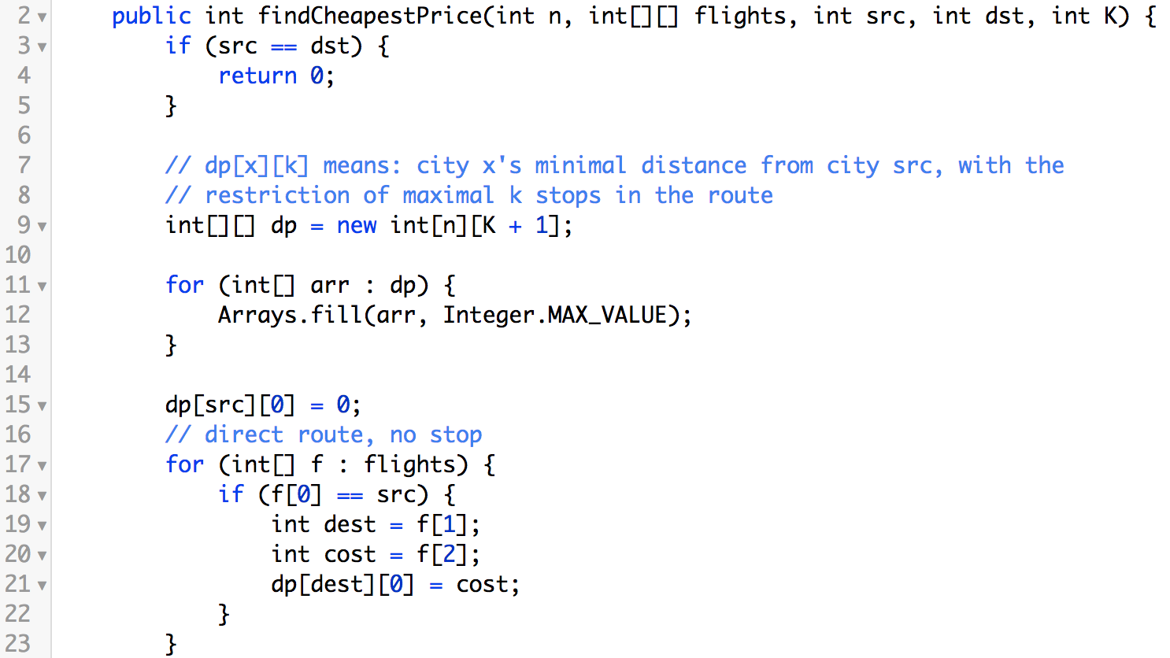

Slide 38
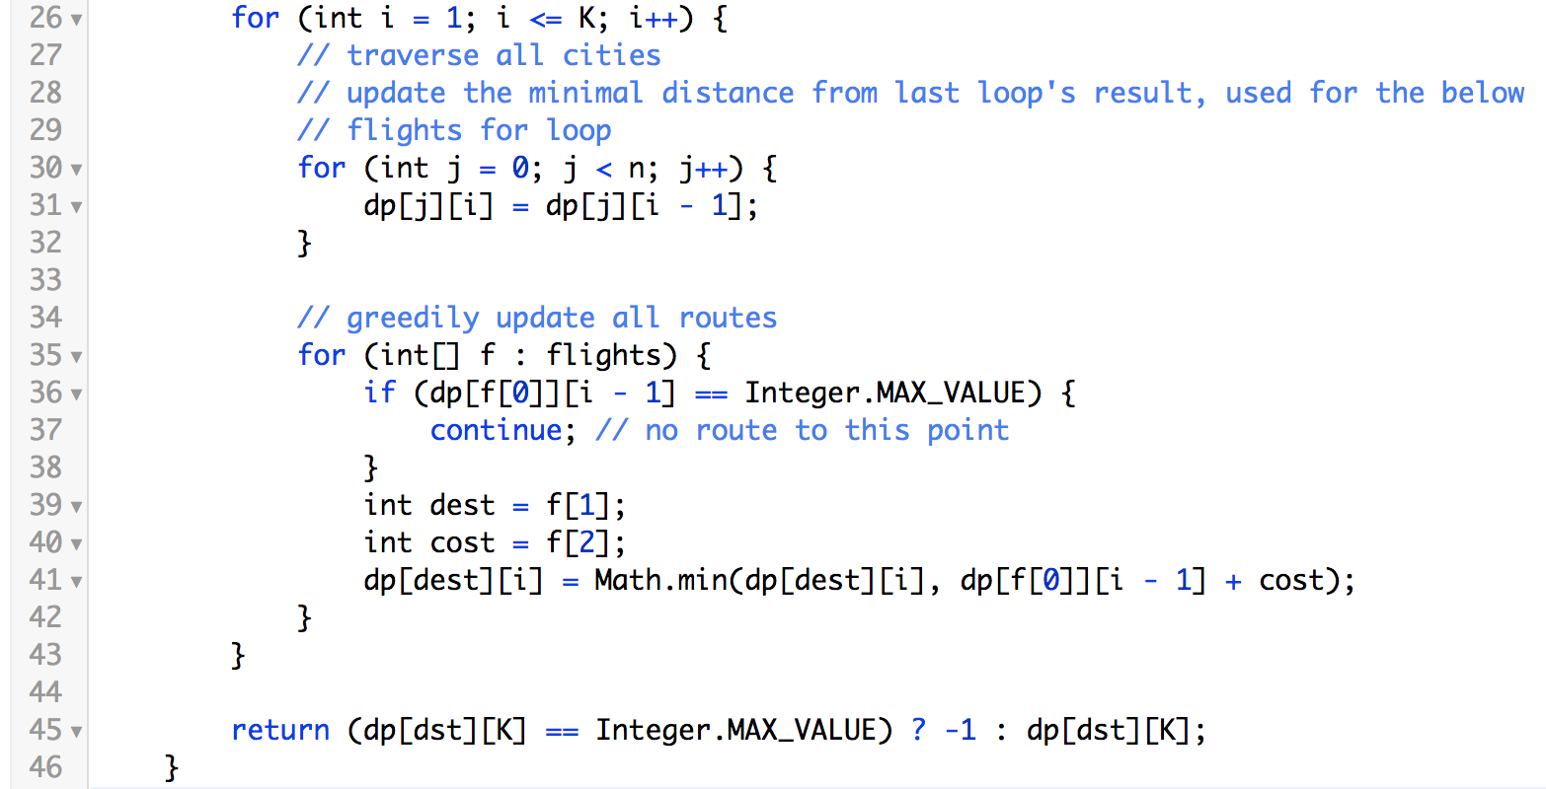

Slide 39
（3） Space Improvement (Bonus)
 | 0 stop | 1 stop | 2 stops
City 0 | 0 | 0 | MAX
City 1 | 100 | 100 | MAX
City 2 | 500 | 200 | MAX
City 3 | MAX | 400 | MAX
City 4 | MAX | 900 | MAX
We only need previous column

Slide 40
（3） Space Improvement (Bonus)
 | 0 stop | 1 stop | 2 stops
City 0 | 0 | 0 | MAX
City 1 | 100 | 100 | MAX
City 2 | 500 | 200 | MAX
City 3 | MAX | 400 | MAX
City 4 | MAX | 900 | MAX
Two dimensional array ➔ One dimensional array

Slide 41
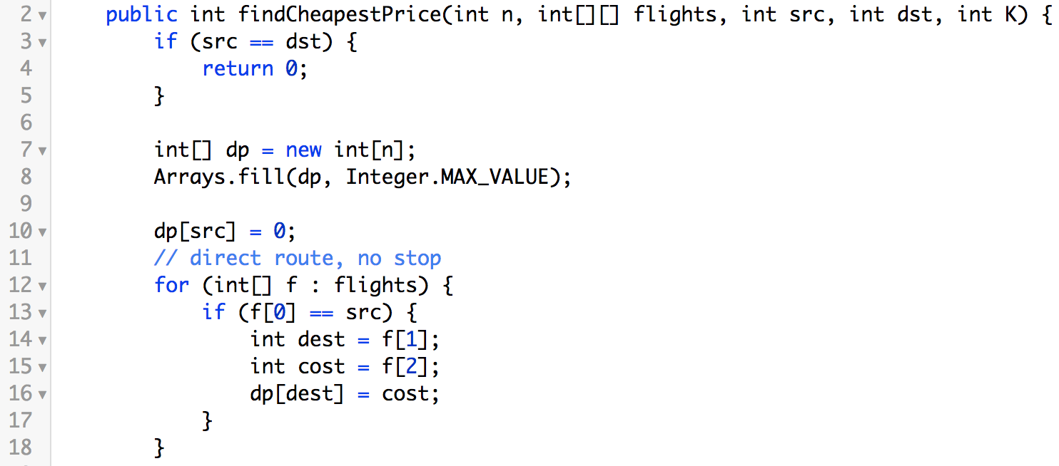

Slide 42
（3） Space Improvement (Bonus)
dp
prev
next
 | 0 stop | 1 stop | 2 stops
City 0 | 0 | 0 | MAX
City 1 | 100 | 100 | MAX
City 2 | 500 | 200 | MAX
City 3 | MAX | 400 | MAX
City 4 | MAX | 900 | MAX

Slide 43
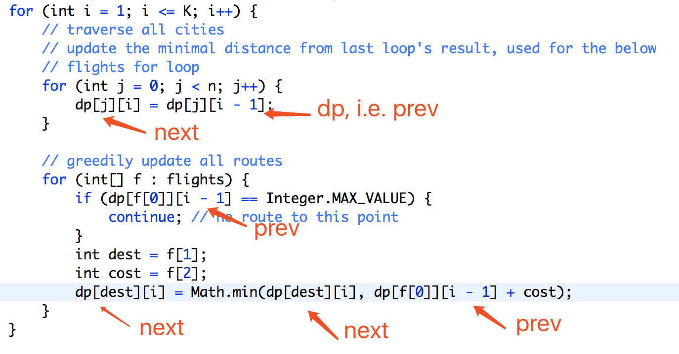

Slide 44
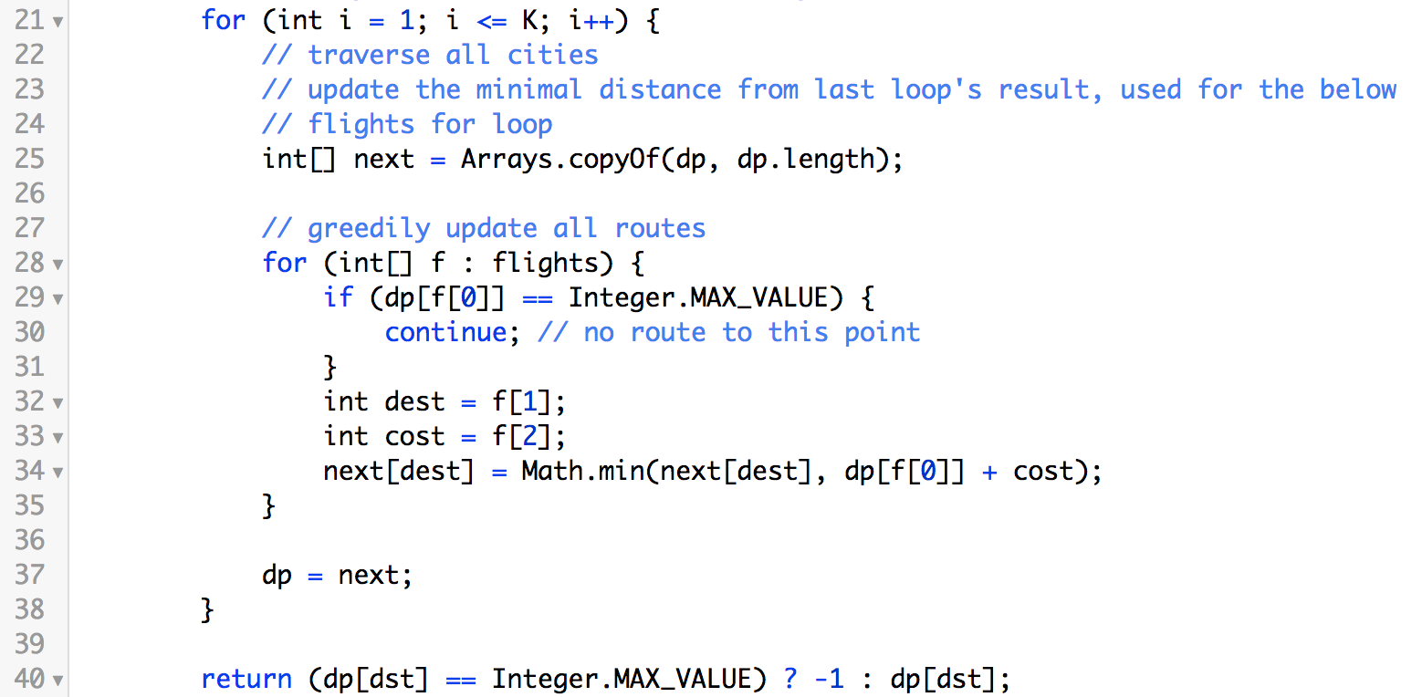

Slide 45
Xcode Career Service
有任何问题，请咨询 xc0d3@outlook.com

